Slide 1
07 08 2025
SMARTSTAT
CICI LU

Slide 2
WHY?

Slide 3
WHY?
In many real-world situations, we have lots of data. For example, from marketing campaigns, surveys, or customer feedback. One way of analysing it is using Statistical Tests. But we don’t know how to conduct statistical analysis on it.
SmartStat is designed to solve that problem!

Slide 4
WHY?
In many real-world situations, we have lots of data. For example, from marketing campaigns, surveys, or customer feedback. One way of analysing it is using Statistical Tests. But we don’t know how to conduct statistical analysis on it.
SmartStat is designed to solve that problem!
It guides users step-by-step through a series of simple questions about their data:
1. What kind of data do you have — numbers or categories?
2. How is it structured — two groups, paired, or multiple variables?
3. Do you assume normal distribution?

Slide 5
CONTENT
01
Independent t-test
04
Pearson correlation test
02
Paired t-test
05
Chi-Square test
03
ANOVA
06
Proportion test (Z-test)

Slide 6
PART 01
Independent t-test
Compare the averages of two groups and determine if the difference is statistically meaningful, or just due to random variation.

Slide 7
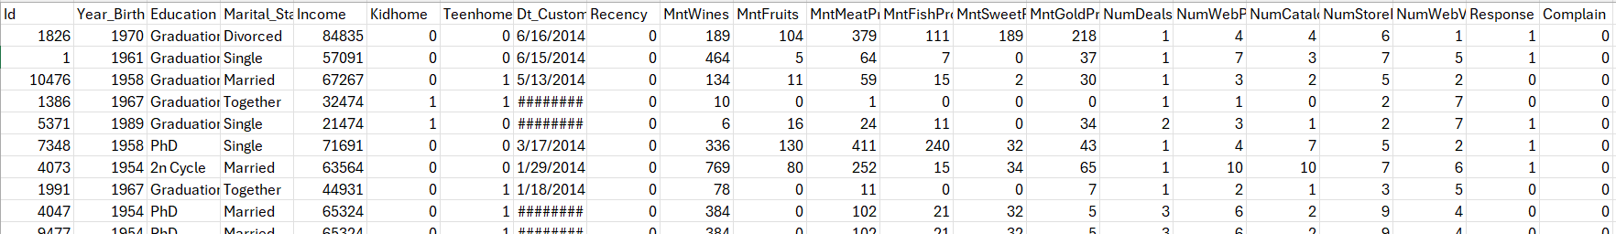
Independent t-test
Response: Whether the customer accepted the promotion (1 = Yes, 0 = No)
Income: The customer’s yearly household income

Slide 8
Independent t-test
Response: Whether the customer accepted the promotion (1 = Yes, 0 = No)
Income: The customer’s yearly household income
Is there a significant difference in income between customers who accepted the promotion and those who didn’t?

Slide 9
PART 02
Paired t-test
Compare the averages of two related measurements from the same individuals, and determine whether the difference between them is statistically meaningful.

Slide 10
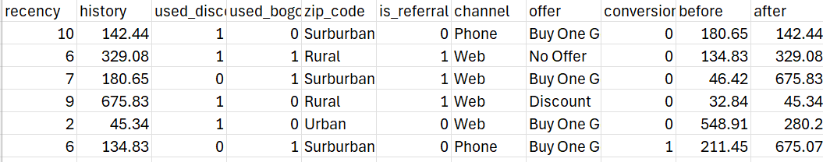
PAIRED t-test
Before: The customer’s total spending before using a “Buy One Get One” offer
After: The customer’s total spending after using the offer

Slide 11
PAIRED t-test
Before: The customer’s total spending before using a “Buy One Get One” offer
After: The customer’s total spending after using the offer
Is there a significant difference in spending between when the same customers used the offer and when they did not?

Slide 12
PART 03
ANOVA
Compare the averages across three or more groups, and determine whether at least one group is significantly different from the others.

Slide 13
ANOVA
Offer: The type of promotion received — this has three categories: Buy One Get One, Discount, No Offer
History: The total amount each customer has spent — this is our numerical variable

Slide 14
ANOVA
Offer: The type of promotion received — this has three categories: Buy One Get One, Discount, No Offer
History: The total amount each customer has spent — this is our numerical variable
Is there a significant difference in customer spending based on the type of promotion they received?

Slide 15
PART 04
Pearson correlation test
Compare the two numerical variables, and determine whether they are linearly related to each other.

Slide 16
Pearson correlation test
Recency: Number of days since their last purchase
History: The total amount each customer has spent

Slide 17
Pearson correlation test
Recency: Number of days since their last purchase
History: The total amount each customer has spent
Is there a relationship between how much a customer has spent and how recently they made a purchase?

Slide 18
PART 05
Chi-Square test
Compare the two categorical variables, and determine whether they are statistically associated.

Slide 19
CHI-SQUARE test
Offer: Three types.
Conversion: Whether a customer made a purchase(1 = Yes, 0 = No)

Slide 20
CHI-SQUARE test
Offer: Three types.
Conversion: Whether a customer made a purchase(1 = Yes, 0 = No)
Does the type of promotion offered affect whether a customer converts or not?

Slide 21
PART 06
Proportion test (Z-test)
Used to determine whether the proportion of successes in a sample differs significantly from a known or hypothesized population proportion.

Slide 22
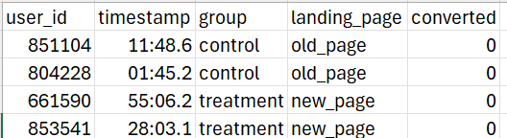
PROPORTION TEST (Z-test)
Group: Which campaign the user was assigned to, control represent the standard ad while treatment represent the new version of ad.
Converted: Whether the user made a purchase

Slide 23
PROPORTION TEST (Z-test)
Group: Which campaign the user was assigned to, control represent the standard ad while treatment represent the new version of ad.
Converted: Whether the user made a purchase
Does the new ad significantly improve conversion rates?

Slide 24
Thank you
07 08 2025
CICI LU
Phone: 0432 910 870
Email: cici.lu@clemengerbbdo.com

